Slide 1
Decision Trees, Random Forest and Ensemble Methods
WIA1007

Slide 2
Decision trees
Non-linear classifier - Target function is discrete valued
Easy to use
Easy to interpret
Susceptible to overfitting but can be avoided.
Examples:
Medical diagnosis Credit risk analysis
Natural Language Processing

Slide 3
Anatomy of a decision tree
Each node is a test on one attribute
Outlook
sunny
overcast
rain
Possible attribute values
of the node
Humidity
Yes
Windy
high
normal
true
false
Leafs (class) are
the decisions
No
Yes
No
Yes

Slide 4
Anatomy of a decision tree
Sample size
Each node is a test on one attribute
Outlook
Your data gets smaller
sunny
overcast
rain
Possible attribute values
of the node
Humidity
Yes
Windy
high
normal
true
false
Leafs are the
decisions
No
Yes
No
Yes

Slide 5
To ‘play tennis’ or not.
Test example: (Outlook==rain) and (Windy==false)
Outlook
sunny
Decision is yes.
overcast
rain
Humidity
Yes
Windy
high
normal
true
false
No
Yes
No
Yes

Slide 6
To ‘play tennis’ or not.
(Outlook ==overcast) -> yes
(Outlook==rain) and (not Windy==True) ->yes
(Outlook==sunny) and (Humidity=normal) ->yes
Outlook
sunny
overcast
rain
Humidity
Yes
Windy
high
normal
true
false
No
Yes
No
Yes

Slide 7
Day | Outlook | Temp. | Humidity | Wind | Play Tennis
D1 | Sunny | Hot | High | Weak | No
D2 | Sunny | Hot | High | Strong | No
D3 | Overcast | Hot | High | Weak | Yes
D4 | Rain | Mild | High | Weak | Yes
D5 | Rain | Cool | Normal | Weak | Yes
D6 | Rain | Cool | Normal | Strong | No
D7 | Overcast | Cool | Normal | Weak | Yes
D8 | Sunny | Mild | High | Weak | No
D9 | Sunny | Cold | Normal | Weak | Yes
D10 | Rain | Mild | Normal | Strong | Yes
D11 | Sunny | Mild | Normal | Strong | Yes
D12 | Overcast | Mild | High | Strong | Yes
D13 | Overcast | Hot | Normal | Weak | Yes
D14 | Rain | Mild | High | Strong | No

Slide 8
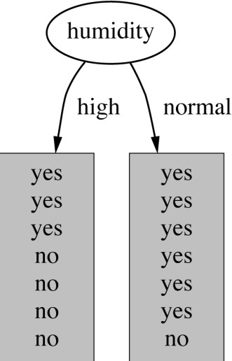
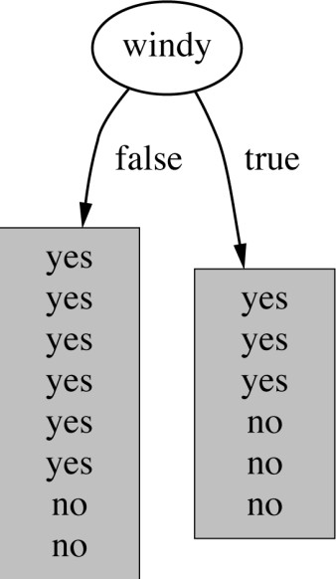
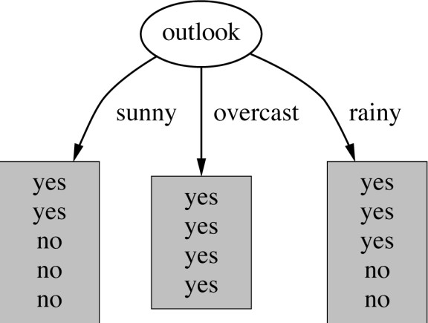
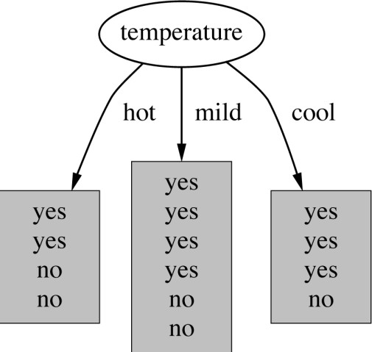
How do we choose the test ?
Which attribute should be used as the test?
Intuitively, you would prefer the one that separates the training examples as much as possible.

Slide 9
Im(purity) Measures
Gini
Information gain/entropy
Chi-square test (HOMEWORK)

Slide 10

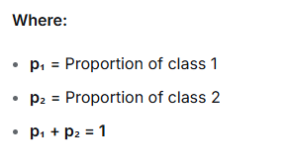
Gini for Binary Classification
For Two Classes (Yes/No, Cat/Dog):

Slide 11
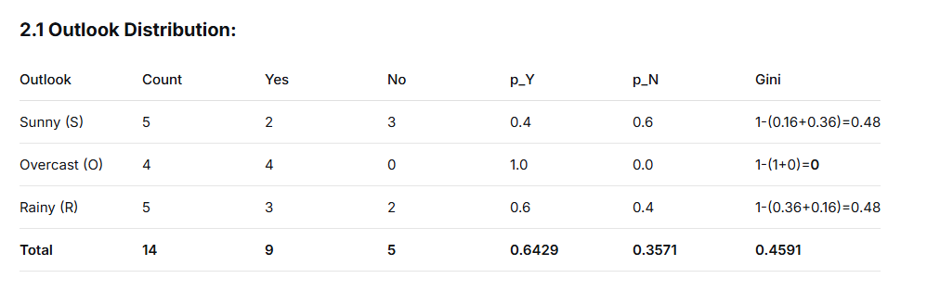
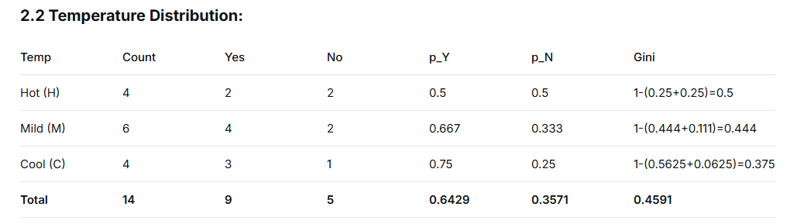
2. DISTRIBUTION TABLES FOR EACH ATTRIBUTE

Slide 12
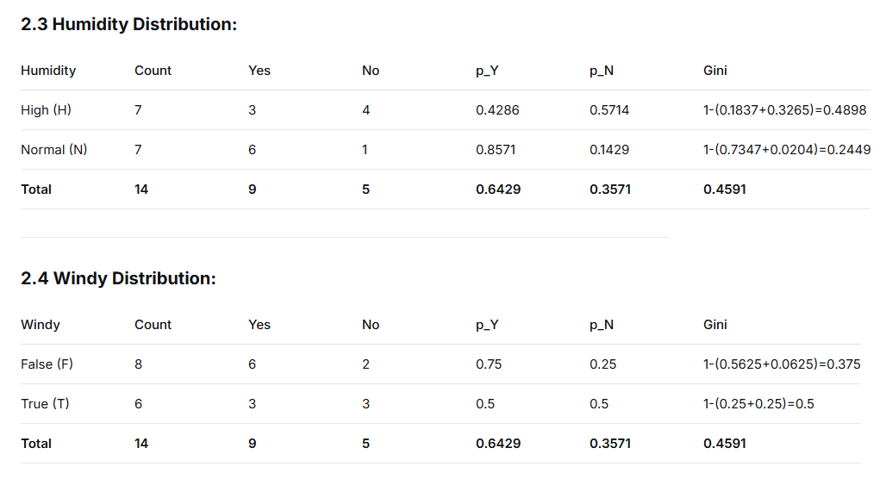

Slide 13
ROOT NODE SELECTION
Step 1: Calculate Root Gini
Total: 14 (9Y, 5N)
p_Y = 9/14 = 0.6429
p_N = 5/14 = 0.3571
Gini_root = 1 - (0.6429² + 0.3571²)
= 1 - (0.4133 + 0.1276)
= 1 - 0.5409 = 0.4591

Slide 14
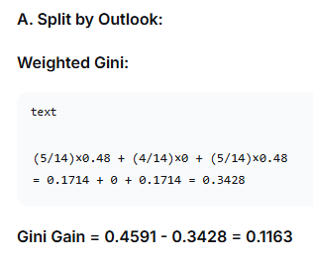
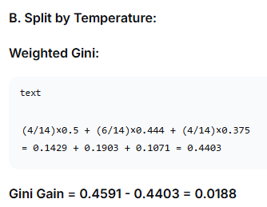
ROOT NODE SELECTION WITH ALL 4 FEATURES
Root Gini = 0.4591

Slide 15
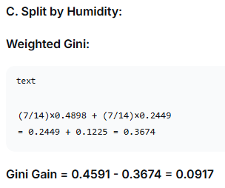
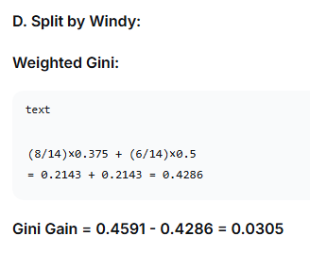
ROOT NODE SELECTION WITH ALL 4 FEATURES
Root Gini = 0.4591

Slide 16
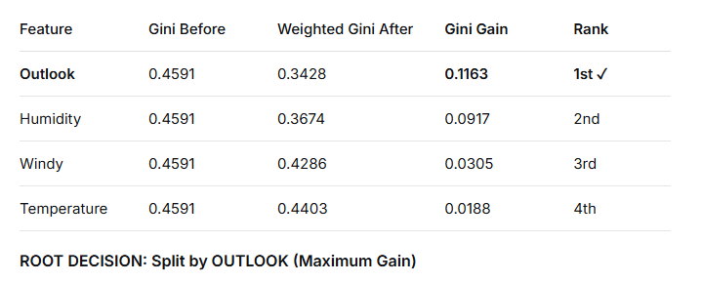
Comparison Table for Root:

Slide 17
SECOND LEVEL SPLITS WITH CROSS-TABLES

Slide 18
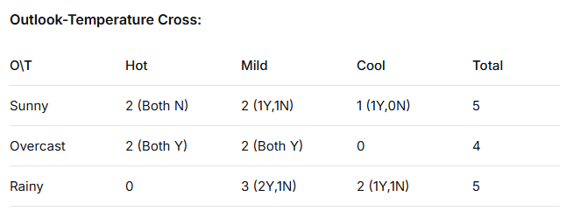
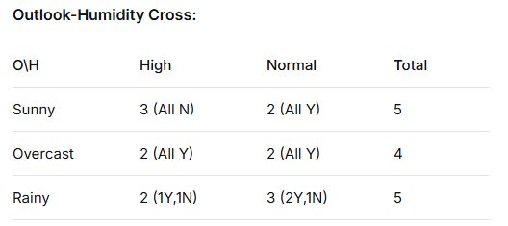
Cross-Distribution Tables:

Slide 19
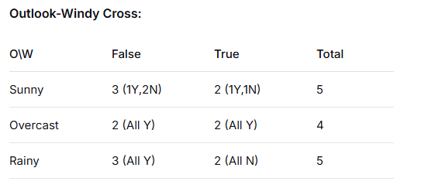
Cross-Distribution Tables:

Slide 20
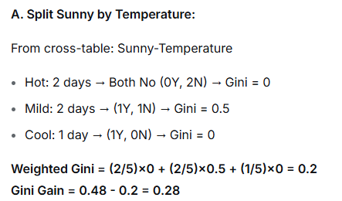
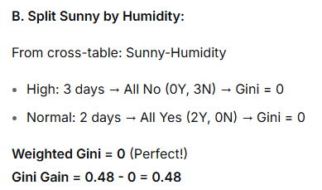
SECOND LEVEL NODE SELECTION WITH REMAINING 4 FEATURES – Branch 1: Sunny (5 days, 2Y, 3N)
Sunny Current Gini = 0.48

Slide 21
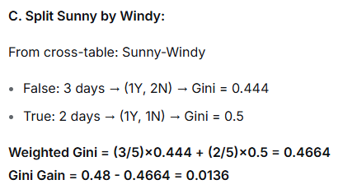
SECOND LEVEL NODE SELECTION WITH REMAINING 4 FEATURES – Branch 1: Sunny (5 days, 2Y, 3N)
Sunny Current Gini = 0.48
Decision for Sunny Branch: Split by Humidity (Max Gain = 0.48)

Slide 22
SECOND LEVEL NODE SELECTION WITH REMAINING 4 FEATURES – Branch 2: Overcast (4 days, 4Y, 0N)
Overcast Current Gini = 0
Decision: LEAF NODE = "Yes" (Always play when overcast)

Slide 23
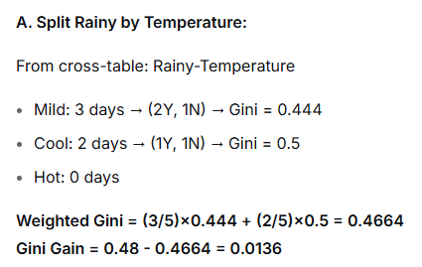
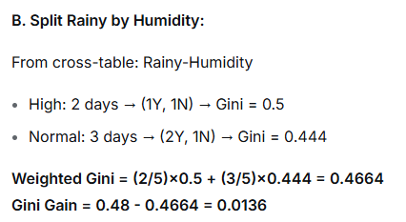
SECOND LEVEL NODE SELECTION WITH REMAINING 4 FEATURES – Branch 3: RAINY (5 days, 3Y, 2N)
Raining Current Gini = 0.48

Slide 24
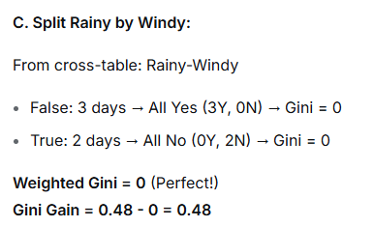
SECOND LEVEL NODE SELECTION WITH REMAINING 4 FEATURES – Branch 3: RAINY (5 days, 3Y, 2N)
Raining Current Gini = 0.48
Decision for Rainy Branch: Split by Windy (Max Gain = 0.48)

Slide 25
Third LEVEL SPLITS

Slide 26
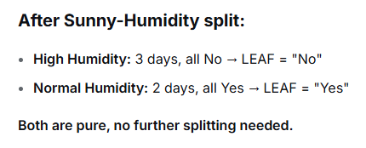
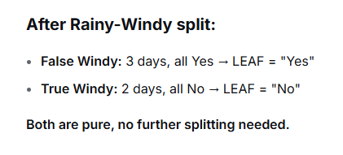
THIRD LEVEL SPLITS (If needed)

Slide 27
To ‘play tennis’ or not.
(Outlook ==overcast) -> yes
(Outlook==rain) and (not Windy==True) ->yes
(Outlook==sunny) and (Humidity=normal) ->yes
Outlook
sunny
overcast
rain
Humidity
Yes
Windy
high
normal
true
false
No
Yes
No
Yes

Slide 28
Entropy
Entropy measures the amount of uncertainty
in a probability distribution
H ( X ) = E(I ( X )) = ∑ p(x_{i} )I (x_{i} ) = −∑ p(x_{i} ) log₂ p(x_{i} )
i i
For binary classification (Yes/No):
Entropy = -[p_Y × log₂(p_Y) + p_N × log₂(p_N)]
Entropy ranges from 0 bits (pure) to 1 bit (50/50 mix for 2 classes)

Slide 29
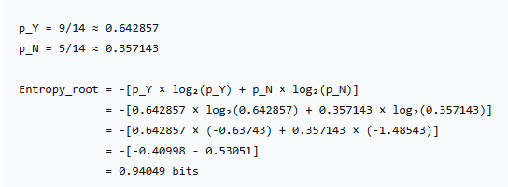
Entropy
Play Tennis dataset - two target classes: yes and no
Out of 14 instances, 9 classified yes, rest no
Current uncertainty: 0.94049

Slide 30
Information Gain
The expected reduction in entropy caused by partitioning the instances from S according to a given discrete variable.
| S
Gain(S, X ) = E(S) -
∑
j
xij
|E(S )
i
| S |
xij
where S_{xij} is the subset of instances from S s.t. X_{i}=x_{ij.}
Information gain =
(information before split) – (information after split)

Slide 31
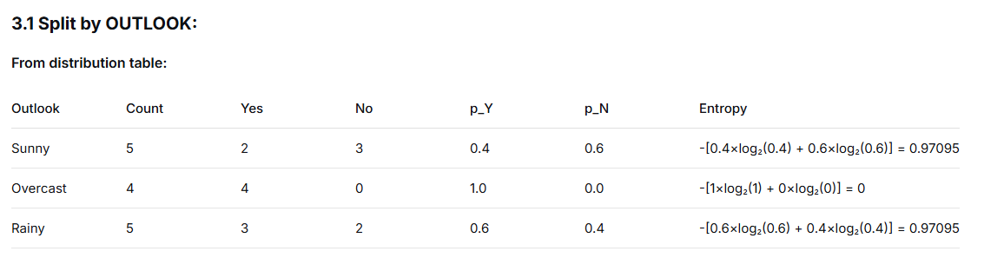


CALCULATE ENTROPY FOR EACH SPLIT
Weighted Entropy:
Information Gain:

Slide 32
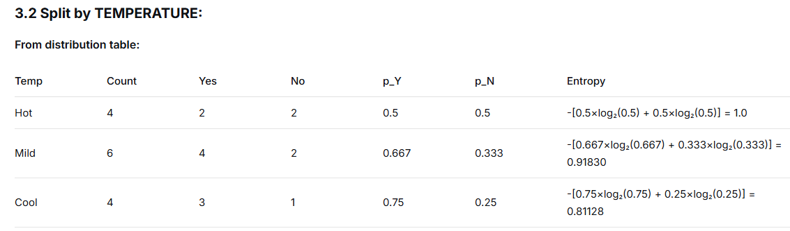


CALCULATE ENTROPY FOR EACH SPLIT
Weighted Entropy:
Information Gain:

Slide 33
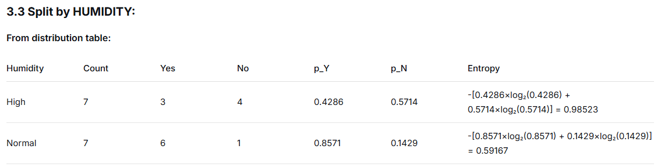


CALCULATE ENTROPY FOR EACH SPLIT
Weighted Entropy:
Information Gain:

Slide 34
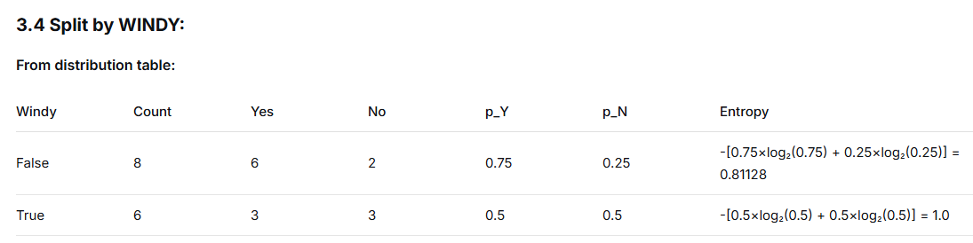


CALCULATE ENTROPY FOR EACH SPLIT
Weighted Entropy:
Information Gain:

Slide 35
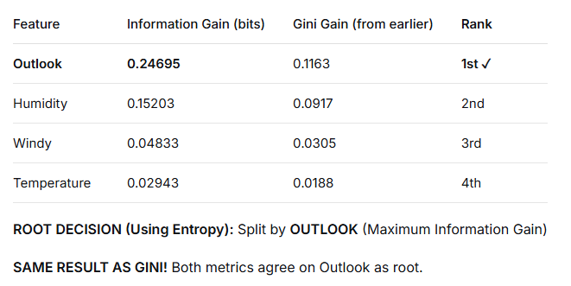
COMPARE ALL FEATURES FOR ROOT

Slide 36
SECOND LEVEL SPLITS USING ENTROPY

Slide 37

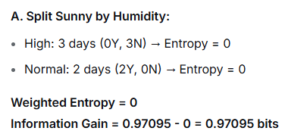
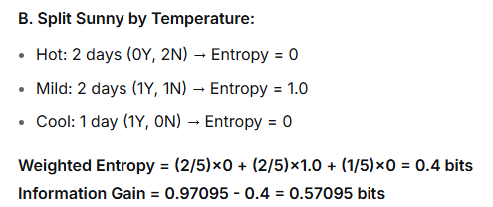
SECOND LEVEL SPLITS USING ENTROPY
BRANCH 1: SUNNY (5 days, 2Y, 3N)
Sunny Current Entropy:

Slide 38
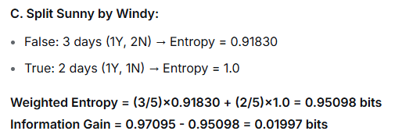
SECOND LEVEL SPLITS USING ENTROPY
BRANCH 1: SUNNY (5 days, 2Y, 3N)
Sunny Current Entropy:
Decision for Sunny Branch: Split by Humidity (Max IG = 0.97095 bits)

Slide 39
SECOND LEVEL SPLITS USING ENTROPY
BRANCH 1: OVERCAST (4 days, 4Y, 0N)
Overcast Current Entropy: 0 (Pure node)
Decision: LEAF NODE = "Yes"

Slide 40

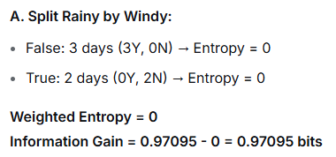
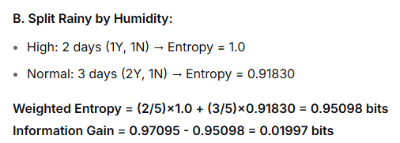
SECOND LEVEL SPLITS USING ENTROPY
BRANCH 1: RAINY (5 days, 3Y, 2N)
Rainy Current Entropy:

Slide 41
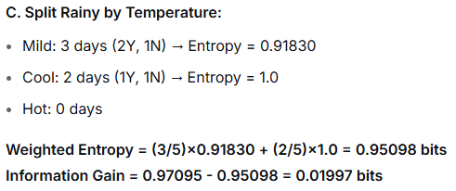
SECOND LEVEL SPLITS USING ENTROPY
BRANCH 1: RAINY (5 days, 3Y, 2N)
Rainy Current Entropy:
Decision for Rainy Branch: Split by Windy (Max IG = 0.97095 bits

Slide 42
THIRD LEVEL SPLITS (If needed)

Slide 43
To ‘play tennis’ or not.
(Outlook ==overcast) -> yes
(Outlook==rain) and (not Windy==True) ->yes
(Outlook==sunny) and (Humidity=normal) ->yes
Outlook
sunny
overcast
rain
Humidity
Yes
Windy
high
normal
true
false
No
Yes
No
Yes

Slide 44
Overfitting
You can perfectly fit to any training data
Zero bias, high variance
Two approaches:
Pre-pruning - Stop growing the tree when further splitting the data does not yield an improvement
Grow a full tree, then prune the tree, by eliminating nodes (post-prune)

Slide 45
Decision tree
Not so ideal for predicting - inaccuracy
- not so flexible in classifying based on new dataset
Instability – a change in data can change the look of a tree

Slide 46
Random Forest
Create a bootstrapped dataset
Build Random Forest
Evaluate
Repeat Step 2 with more features

Slide 47
Bagging
Bagging or Bootstrap aggregating - a technique for reducing the variance of an estimated prediction function.
  the variance in the prediction is reduced (no big loss from the random errors that a single classifier is bound to make).
Bagging:
  Sample M bootstrap samples.
  Train M different classifiers on these bootstrap samples
  For a new query, let all classifiers predict and take an
average (or majority vote)

Slide 48
Bagging
A bootstrap sample is chosen at random with replacement from the data. Some observations end up in the bootstrap sample more than once, while others are not included (“out of bag”).
Bagging reduces the variance of the base learner but has limited effect on the bias.
•It’s most effective if we use strong base learners that have very little bias but high variance (unstable). E.g. trees.
Both bagging and boosting are examples of “ensemble learners” that
were popular in machine learning in the ‘90s.

Slide 49
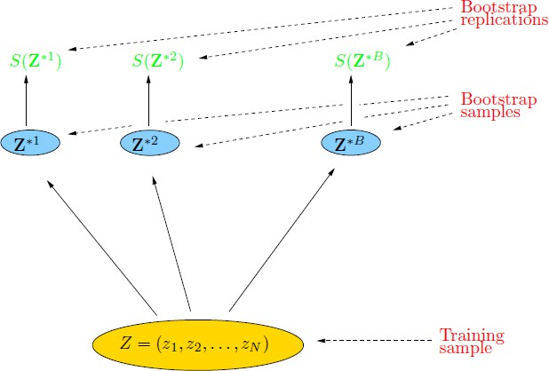
Bootstrap
The basic idea:
randomly draw datasets with replacement from the
training data, each sample the same size as the original training set

Slide 50
Random Forest Classifier
Create bootstrap samples
from the training data
M features
N examples
....…

Slide 51
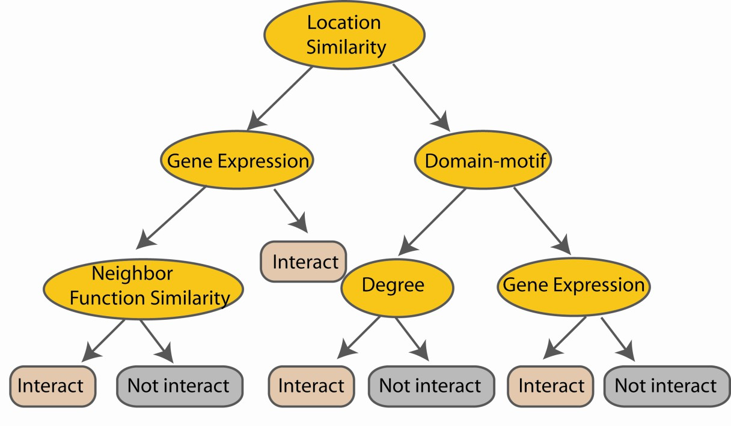
Random Forest Classifier
Construct a decision tree
M features
N examples
....…

Slide 52

Random Forest Classifier
At each node in choosing the split feature choose only among m<M features
M features
N examples
....…

Slide 53

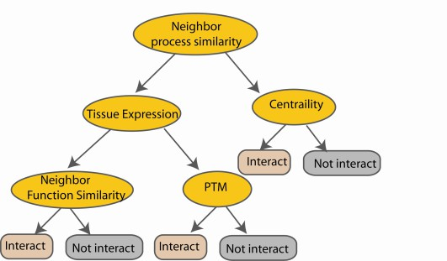
Random Forest Classifier
Create decision tree from each bootstrap sample
M features
N examples
....…
....…

Slide 54
Random Forest Classifier
M features
N examples
Take he majority vote
....…
....…

Slide 55
Additional Info - Boosting
Main idea:
train classifiers (e.g. decision trees) in a sequence.
a new classifier should focus on those cases which were incorrectly classified in the
last round (get higher weights)
Each boosting round learns a new (simple) classifier on the weighed dataset.
These classifiers are weighed to combine them into a single powerful classifier.
Combine the classifiers by letting them vote on the final prediction (like bagging).
Stop by using monitoring a hold out set (cross-validation).

Slide 56
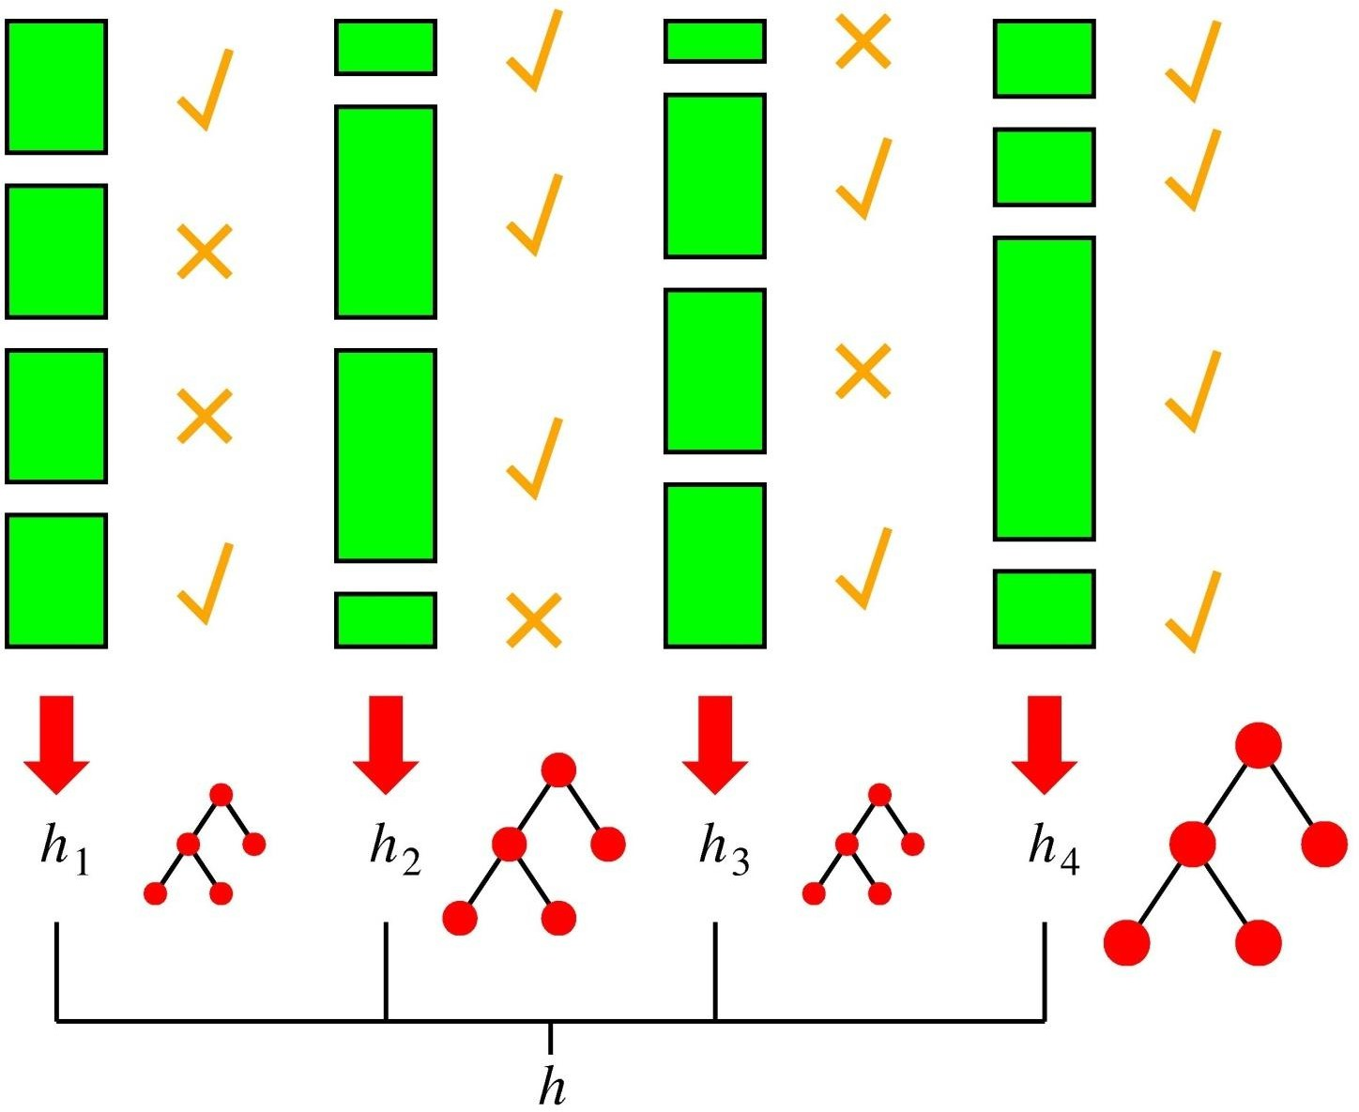
Boosting in a Picture
boosting rounds
training cases
correctly
classified
training case has large weight in this round
this DT has
a strong vote.

Slide 57
Thank You

